Slide 1
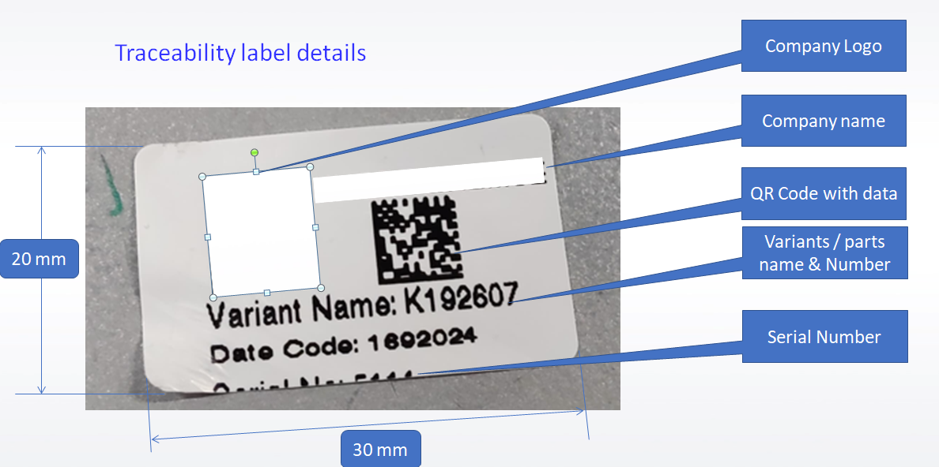
Traceability details

Slide 2
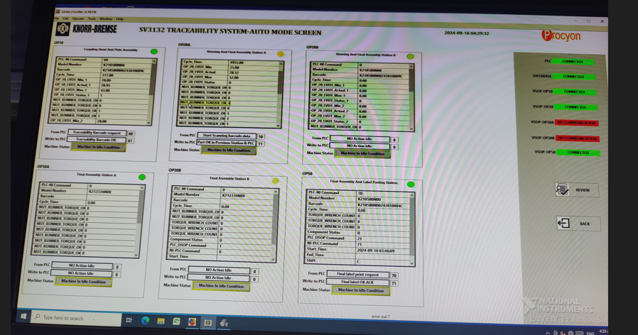
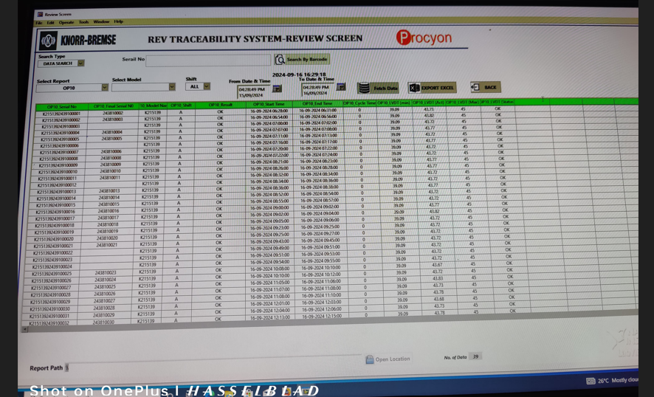
Traceability details
Station wise traceability data at the EOL IPC Computer
Data export in the excel sheet

Slide 3
Traceability details
Traceability Requirements
1.The variants selection should be available at the 1st station of assembly set up.
2.Station wise data should be store in central computer which is at EOL station
3.Station wise data screen available at the EOL IPC computer.
4.Station wise data should be export & compile in the excel format.

Slide 4
Thank You

